Slide 1

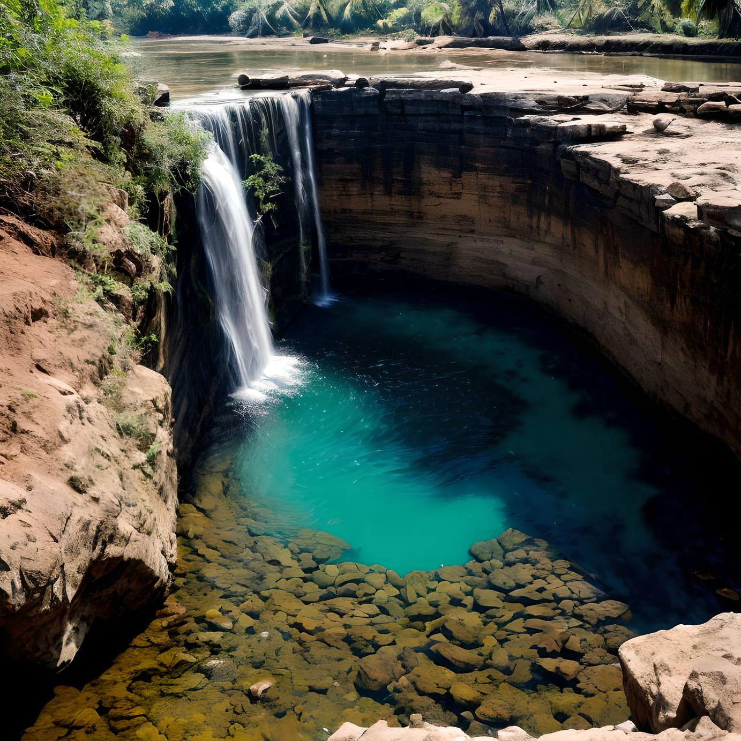


By Aarti ZIkre
India Water Portal
This project uses smart marketing to fix water problems in India by informing people and changing policies for better water management.
page 01

Slide 2
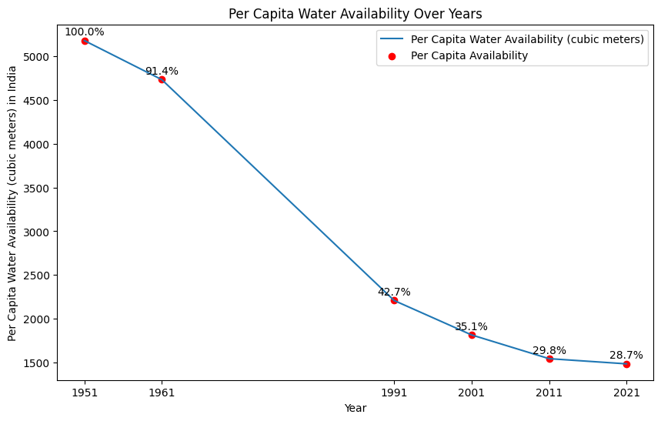


Why Important ?
The data from the Indian water government reveals a concerning trend: the amount of water available per person has dropped to less than one-third of what it was in 1951.
page 02

Slide 3
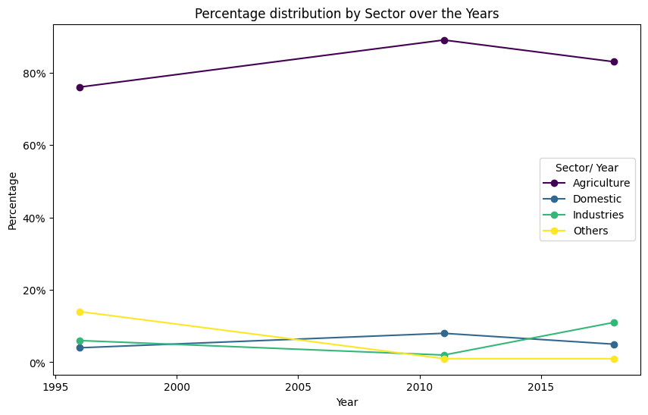

Where we are using our water?
In India, the agriculture sector still uses the most water compared to other sectors.
page 03

Slide 4
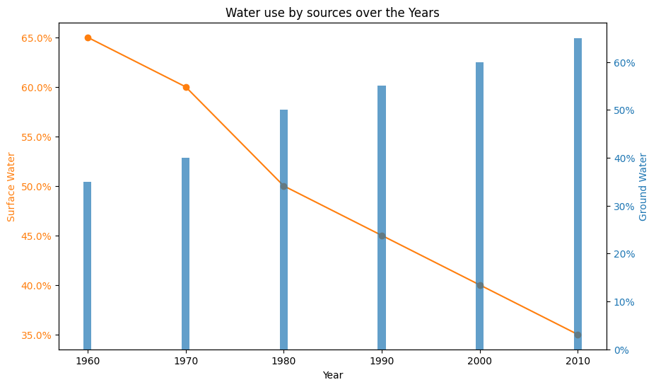


Where !!
The information shows that where we get our water from has changed a lot. In 1960, we mostly used water from rivers and lakes, but by 2010, we started using more water from underground.
page 04

Slide 5
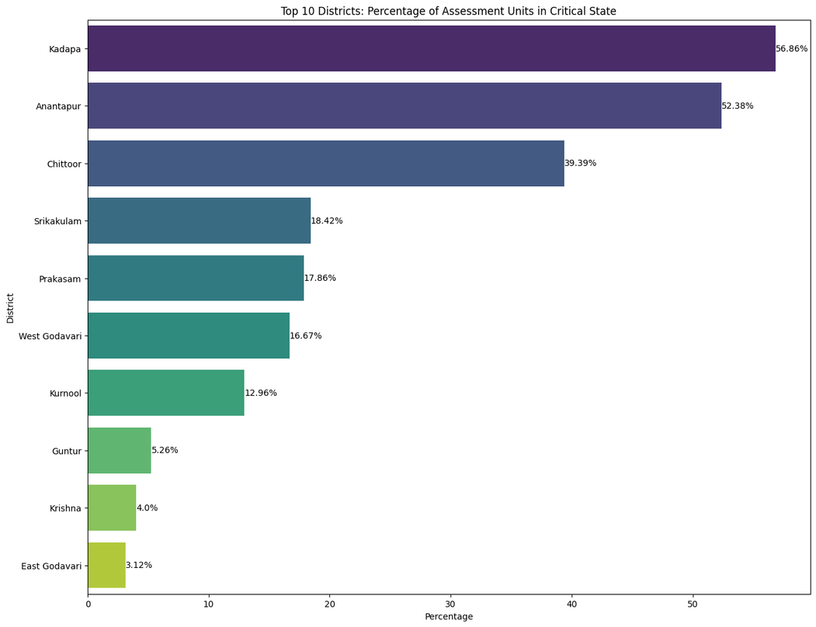


Importance
Many of our Assessment Units have less water than they can hold. The top 10 units are in a critical situation, meaning they have a severe shortage of water. Among them “Kapada” is first one.
page 06

Slide 6
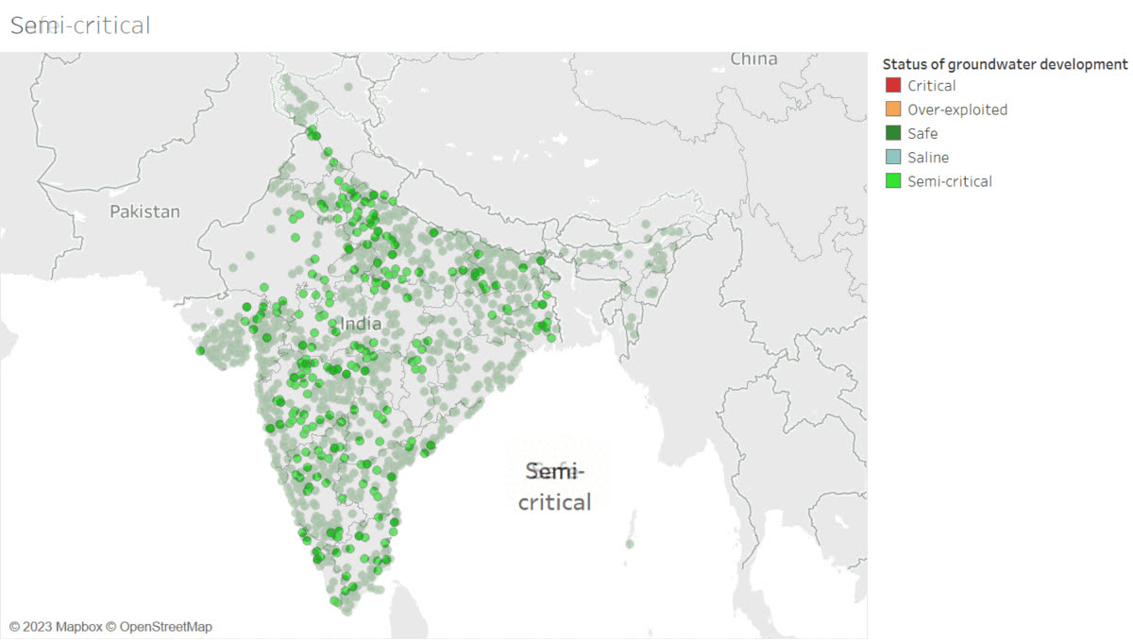
Water assissment units:
Safe : 4310
Saline : 100
over-exploited : 1186
Semi Critical : 972
Critical : 313
page 06

Slide 7
Thank
you

